Slide 1
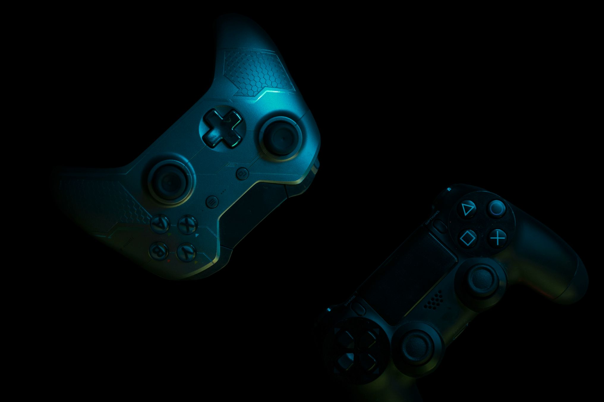


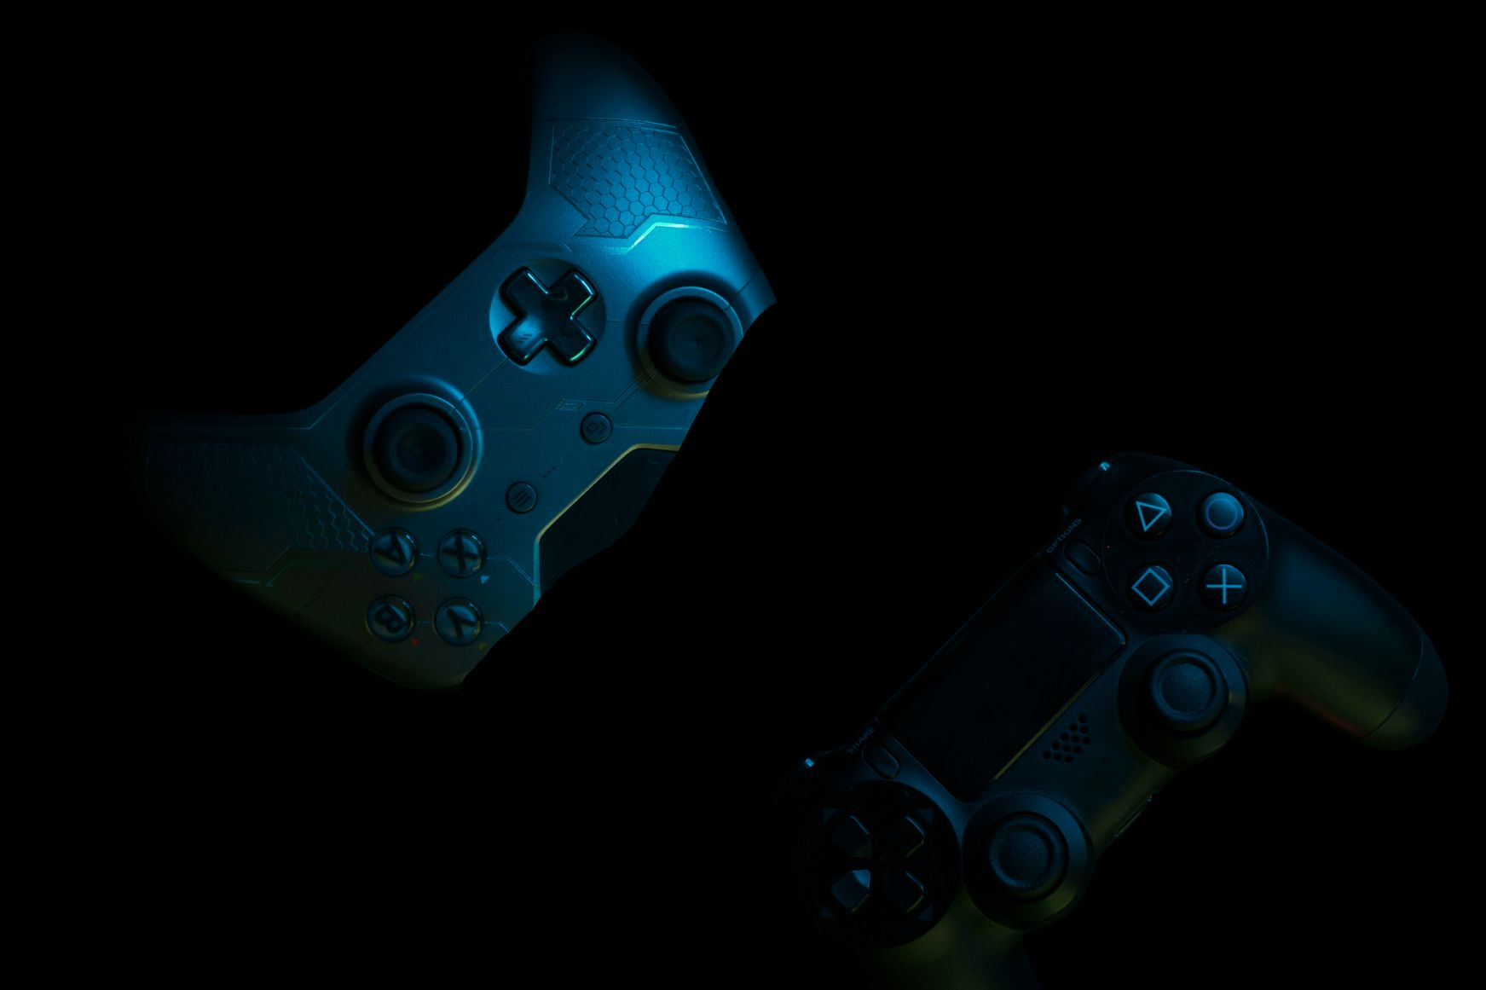
SAFETY AND WE
IOT-BASED WEARABLE DEVICES FOR THE SAFETY AND SECURITY OF WOMEN AND GIRL CHILDREN
Supervisor: Prof. Subhrakanta Behera

Slide 2
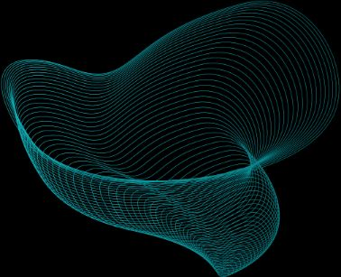

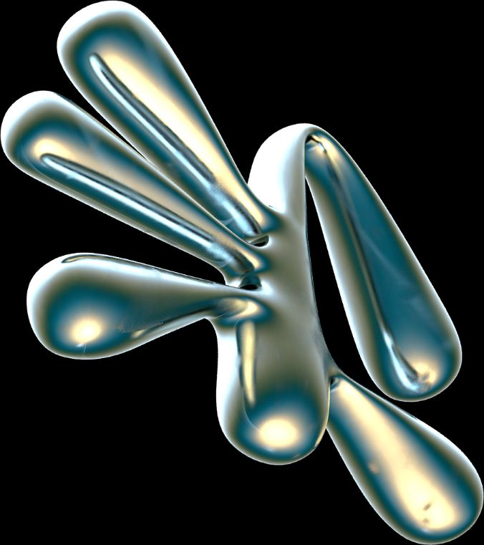
Members:
2130155 Tanmay Singh
2130166 Anikait Barik
2130182 Himanshi Deep
2130202 Manu Siddharth Verma
TABLE OF CONTENTS
01.
02.
Introduction
Design & Implementation
03.
04.
challenges & solutions
Future work & Conclusion

Slide 3


INTRODUCTION
In a world where safety is a constant concern, a groundbreaking solution emerges: IoT-based wearable devices. These discreet guardians go beyond traditional alarms, leveraging the power of the Internet of Things. By seamlessly integrating with daily wear, they offer real-time protection without compromising style.
Imagine a world where women and girls can move freely, unburdened by fear. This vision becomes closer with these innovative wearables. We'll explore how these devices empower them through smart features, fostering a culture of confidence and security.

Slide 4
OBJECTIVE
Enhance Personal Safety: Equip women and girls with a discreet, wearable device that provides a sense of security and protection in any situation.
Enable Real-time Monitoring: Utilize IoT technology to allow pre-designated contacts to monitor the user's location and well-being in real-time, fostering peace of mind for both the wearer and their loved ones.
Facilitate Swift Emergency Response: Integrate features that trigger automatic emergency alerts with accurate GPS location data, allowing for a faster response by emergency services in critical situations.
Empower Through Awareness: Provide optional features that raise awareness of surroundings, such as designated "safe zones" within a mobile app connected to the wearable.

Slide 5
BACKGROUND
Violence against women and girls is a pervasive global issue. Here are some alarming statistics that showcase the need for innovative safety solutions:
Worldwide: The United Nations Office on Drugs and Crime (UNODC) reports that globally, 1 in 3 women have experienced physical or sexual violence in their lifetime, often by an intimate partner [UNODC statistic].
Regional Variations: The rates of violence vary by region, with some areas experiencing significantly higher numbers.
For example, a World Health Organization (WHO) report states that in Southeast Asia, about 37.7% of women have experienced intimate partner violence [WHO statistic].
Impact on Lives: These incidents have devastating consequences, causing physical and emotional harm, limiting mobility, and hindering career opportunities.

Slide 6
REAL LIFE EXAMPLES
News headlines sadly showcase the constant need for increased safety measures:
A recent case involved a woman who was followed home and attacked. A discreet wearable withan emergency alert feature could have potentially deterred the attack or facilitated a faster response.
Another case involved a young girl who went missing while playing outside. A wearable with real-time location tracking could have helped locate her quickly.
These statistics andreal-life examples highlight the urgent need for innovative solutions like IoT-based wearables to empower women and girls and create a safer world.

Slide 7
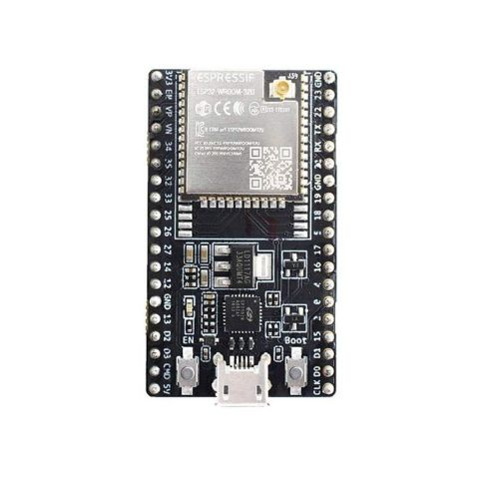
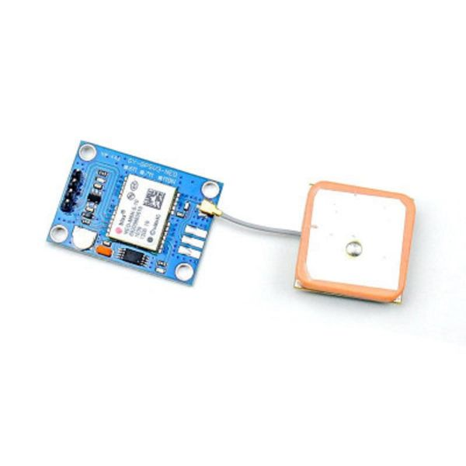
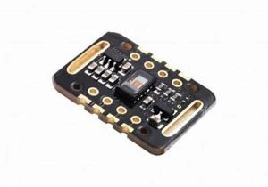

ESP 32 MICROCONTROLLER
MAX3102 & MPU 6050
GPS M8N & SIM 900L
The ESP32 is a series of powerful, yet affordable microcontrollers designed for projects that connect to the internet. They come with built-in Wi-Fi and Bluetooth connectivity, allowing them to wirelessly transmit data or act as a receiver. ESP32s are popular for Internet of Things (IoT) applications because they're low-power and have features like sleep modes to conserve battery life. They're also versatile with built-in memory and processing power enabling them to handle complex tasks.
The core of this wearable is a dynamic duo: the MAX3102 heart rate sensor and the MPU-6050 motion processing unit. The MAX3102, a vital component, meticulously tracks your heart rate, a crucial indicator of your health and potential stress levels. The MPU-6050, its partner in protection, precisely measures your movements and orientation. This combined data becomes a rich treasure trove of information, fueling the wearable's security features and well-being monitoring functionalities.
The proposed wearable device leverages the combined power of the u-blox NEO-M8N GPS module and the SIM900A GSM/GPRS module. The NEO-M8N provides high-accuracy location tracking with fast GPS lock-on times, while the SIM900A enables real-time data transmission over cellular networks. This potent combination allows the wearable to pinpoint the user's location and send emergency alerts with crucial GPS coordinates, facilitating a swift response during critical situations.
KEY COMPONENTS

Slide 8

DESIGN
Concept: The Discreet Guardian is a multi-sensory wearable device designed for the safety of women and girls. It prioritizes user comfort and style, blending seamlessly into daily wear as a bracelet, pendant, or even a hairclip.
Components:
Microcontroller: The brain of the device, responsible for processing sensor data and triggering actions.
Heart Rate Sensor: Monitors the wearer's heart rate in real-time.
Accelerometer: Detects sudden changes in motion, crucial for fall detection.
Microphone (Optional): Records audio for a brief period upon fall detection, providing context for emergency responders.
GPS Module: Tracks the wearer's location and transmits it upon button press.
Battery: Provides power for continuous operation.
Communication Module (GSM/GPRS): Enables real-time data transmission (alerts, location) over cellular networks. (May vary depending on the chosen communication protocol)
Discreet Housing: Ensures comfortable wear and blends into everyday accessories.
Additional Considerations:
Low Power Consumption: Optimizing power usage allows for extended battery life.
Data Security: Implementing robust encryption to safeguard user data.
Alert Discreetness: Providing silent notification options alongside sending alerts to pre-designated contacts.
User Interface: A simple button press or intuitive gestures to activate location sharing or trigger emergency alerts.

Slide 9
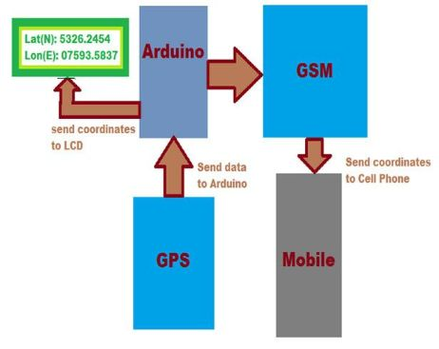
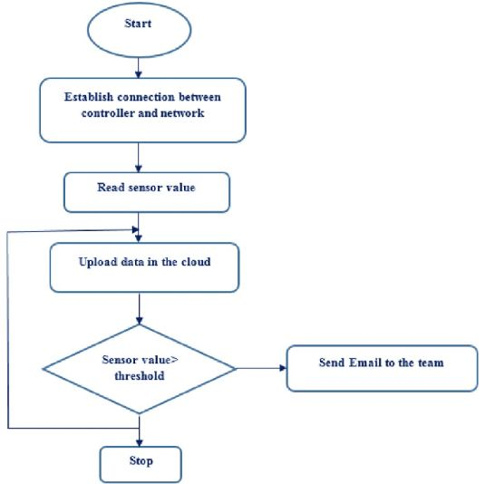
MPU6050
& MAX30102
Block Diagram
Flow Diagram

Slide 10
IMPLEMENTATION
A multi-layered system working tirelessly behind the scenes. The Discreet Guardian starts with a microcontroller, the mastermind that interprets data from various sensors.
Sensing Your Needs: A heart rate sensor monitors your well-being, detecting anomalies. An accelerometer acts as a watchful eye, recognizing sudden movements indicative of falls. Additionally, an optional microphone can briefly capture surrounding audio upon a fall, providing crucial context for emergency responders.
Location at Your Command: A GPS module tracks your location in real-time. With a simple press of a button, this data is transmitted to designated contacts, offering a sense of security.
Communication Lifeline: A communication module (like GSM/GPRS) serves as the lifeline, transmitting alerts and location data over cellular networks. This ensures critical information reaches those who matter most in times of need.

Slide 11
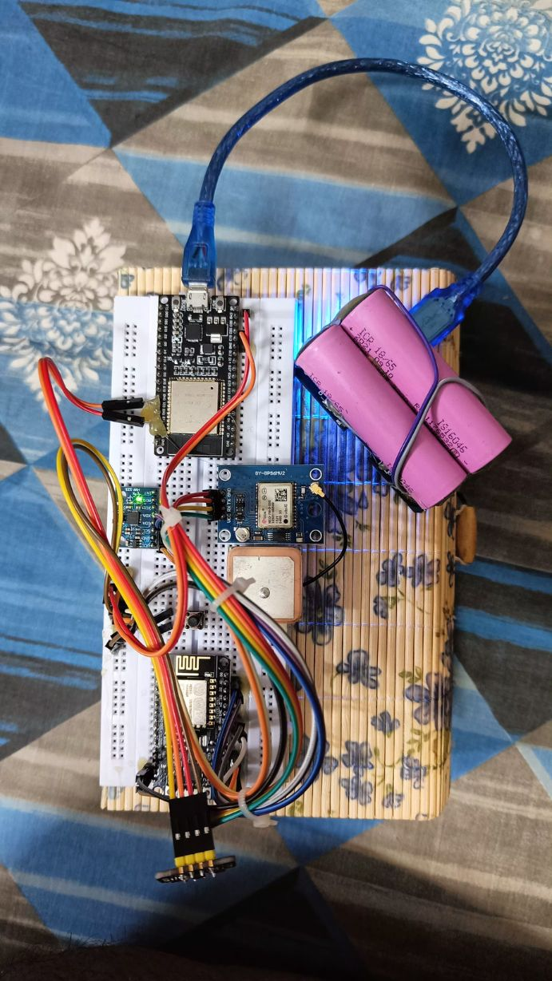
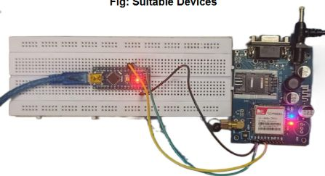
Hardware Model

Slide 12
CLOUD INTEGRITY
The Discreet Guardian works with a special online system (think "cloud storage") that securely collects data from your device, like heart rate and location. This connection, made through a cellular network (like GPRS), lets you:
Get Help from Anywhere: Family or emergency services can access your data (with permission) through a secure app or website, no matter the distance. This allows for a faster response in an emergency.
Learn More About Safety: Over time, the system can analyze your data to identify potential risks. This helps you and your loved ones stay extra cautious in certain areas.
Stay Flexible: The system is designed to grow with you. Future features, like connecting with local emergency services, can be easily added for even more protection.
Benefits:
Always Accessible: Check on your safety or get help from anywhere there's internet.
Data Safeguard: Your information is protected by strong security measures.
Adapts to Your Needs: The system can grow with you, offering new features in the future.
The Discreet Guardian, connected to this online system, goes beyond location to provide global safety.

Slide 13
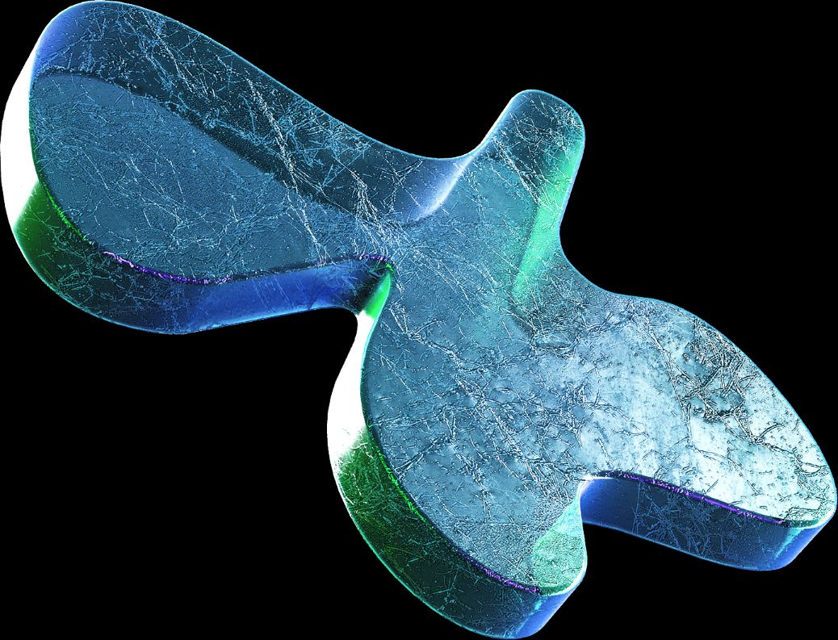

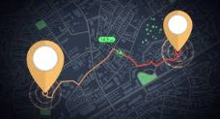



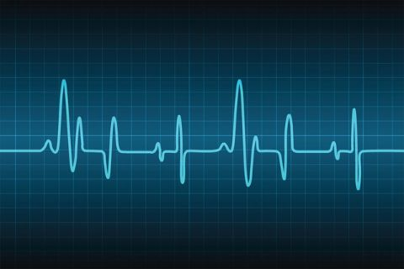
FUNCTIONALITY
How the device works to enhance
safety and security???
Always Located: A built-in GPS module continuously tracks your location, offering a constant sense of security.
Safe Zones: Define safe areas (home, work) through the companion app with geo-fencing. Exiting these zones triggers an alert with your location, ensuring help arrives even in remote areas thanks to the GSM module.
Instant Help: A discreet panic button sends immediate emergency alerts with your location, a pre-recorded message, and user data (like heart rate) for additional context.
Fall Detection: The multi-purpose accelerometer detects falls. If a fall is suspected, an alert with the location is sent, and the optional microphone can briefly record surrounding audio to provide crucial information for emergency responders.

Slide 14


Heart Rate Monitoring
Panic button
A discreet button, easily accessible on the wearable, allows users to send immediate emergency alerts.
Upon activation, the device transmits:
User location via GPS
Pre-recorded messages to designated contacts
User data (heart rate, activity levels - subject to user preference)
A built-in sensor continuously monitors the wearer's heart rate.
Unusual fluctuations could indicate distress and trigger discreet alerts to pre-programmed contacts.
Users can monitor their heart rate data through a companion app for personal wellness insights.
Location-Based Safety:
Activity tracking
Activity Tracking: Monitors daily movement patterns, offering health insights via the companion app.
Fall Detection: Analyzes sudden changes in motion to identify potential falls. If a fall is suspected:
An emergency alert with location is sent to contacts.
The microphone briefly records surrounding audio for context.
The Discreet Guardian combines GPS tracking and Geo-fencing with a GSM module for cellular network connectivity.
Users are constantly tracked (GPS).
Safe zones (e.g., home, workplace) can be set (Geo-fencing).
Exiting a safe zone triggers an emergency alert with location (GSM).

Slide 15

TECHNICAL CHALLENGES
Power Hungry Modules vs. Battery Life: Balancing features like GPS and GSM with long battery life requires compatible, low-power options. The microcontroller needs to communicate efficiently with these modules to minimize drain.
Accurate Sensors & Seamless Work: Reliable fall detection and activity tracking depend on compatible sensors (accelerometer) and the microcontroller working together to collect and interpret data accurately.
Small Size, Big Comfort: Squeezing multiple modules into a comfortable wearable requires compatible component sizes and shapes for efficient integration without compromising user comfort.
Cellular Coverage & Backups: GSM relies on cellular networks. Exploring alternative communication options (like satellite) for areas with weak coverage requires compatible modules that work with the microcontroller for data transmission, but may add cost and complexity.
App Compatibility & User Experience: The companion app needs to talk to the microcontroller and interpret sensor data for a user-friendly experience.
Cost-Effective Choices: Selecting affordable modules that function well together is crucial.

Slide 16

Peace of mind
Safer world
Constant location tracking and emergency alerts reduce user and family anxiety.
Fall detection ensures help arrives even if a user can't call for it.
Discourages crime and empowers bystanders to intervene.
Timely intervention through accurate location data improves emergency response.
BENEFITS & IMPACT
Empowerment
Data-Driven
Advocacy
The Discreet Guardian offers a safety net, fostering peace of mind with features like location tracking and emergency alerts. This empowers women and girls, boosting confidence and deterring threats, allowing them to move freely. It creates a safer world by potentially discouraging crime, improving emergency response, and informing data-driven safety initiatives (with consent).
Boosts confidence for women and girls, allowing them to navigate freely.
The device itself deters potential threats.
Anonymized user data (with consent) can inform policymakers and NGOs about safety trends and areas needing improvement, leading to more effective safety initiatives.

Slide 17
REAL LIFE CHALLENGES
False Alarms: Accidental activation of emergency features can drain batteries and cause unnecessary strain on emergency services.
Discreet Activation: In dangerous situations, it may be difficult or impossible to activate a safety device without alerting the perpetrator.
Social Stigma: Wearing a safety device might be seen as a sign of vulnerability or fear, discouraging some women and girls.
Cost and Accessibility: The cost of these devices can be a barrier for low-income individuals.
Privacy Concerns: Data collected by the devices raises concerns about privacy and potential misuse.

Slide 18
SIMPLIFYING CHALLENGES
False Alarms:
Smart Algorithms:Analyze data to reduce accidental triggers.
User Confirmation: Double press or in-app confirmation minimizes false alerts.
Discreet Activation:
Silent Alerts: Sent to contacts without visible device notification.
Voice Commands: Trigger alerts without needing to touch the device.
Future: Gesture Recognition: Enable even subtler activation methods.
Social Stigma:
Fashionable Design: Collaborate with designers for stylish wearables.
Empowerment Focus: Frame it as a confidence booster and deterrent.
Cost and Accessibility:
Strategic Partnerships: Offer subsidies or discounts for vulnerable populations.
Tiered Pricing: Different feature sets at varying price points.
Privacy Concerns:
Robust Encryption:Strong protocols safeguard data during transmission/storage.
Clear Data Practices: Explain data collection, usage, and sharing.
User Control: Users decide what data is collected and shared.
Anonymized Data: Provides insights without compromising privacy.

Slide 19

WHAT IS
FUTURE & ITS ADVANCEMENTS?
1.
2.
3.
4.
Advanced Biometric Sensors
AI-powered Threat Detection
Optimize Algorithms
Identify User Needs
Incorporate blood oxygen or stress level monitoring for a more holistic safety picture
Develop AI algorithms to analyze sensor data and predict potential dangers, prompting proactive interventions
Continuously refine fall detection, activity tracking, and potential threat prediction for better accuracy.
Tailor features and functionalities based on real-world usage patterns and user feedback.
Continuously improve the companion app's interface and features based on user suggestions

Slide 20
CONCLUSION
By implementing smart features like advanced algorithms and user confirmation steps, accidental alerts can be minimized while empowering users to silently request help in dangerous situations.
Collaborating with designers and framing the device as a confidence booster can combat potential social stigma associated with wearing it. Furthermore, strategic partnerships and tiered pricing structures can ensure affordability and wider accessibility.
Robust data protection and user control over collected information address privacy concerns. By overcoming these challenges, this Discreet Guardian has the potential to become a powerful tool, fostering a world where women and girls can navigate their surroundings with confidence, knowing help is just a silent signal away.

Slide 21


